Slide 1
TLTA ANNUAL CONFERENCE • FRISCO, TEXAS • JUNE 8–10, 2026
RECORDSONLINE
Introducing the
AI Suite for Title.
ChainOfTitleAI • RunsheetAI • CommitmentAI
AI does the research. Our professionals make the judgment.
Built on the patented RecordsOnline title plant

Slide 2

FROM THE FOUNDER
The examiner's judgment is what makes a title commitment complete and accurate. We didn't build the AI Suite to replace that judgment — we built it to extend it.
Celia C. Flowers
Founder, RecordsOnline
Quadruple Board-Certified Texas Attorney — Oil, Gas & Mineral Law • Real Estate Law • Property Owner Association Law • Civil Litigation

Slide 3
OUR POSITION
AI without a human examiner
isn't a title product. It's a liability.
GENERIC AI IN TITLE
RECORDSONLINE AI SUITE
Inconsistent answers across runs
No examiner in the loop
Bolted on to an existing process
Model risk lands on the title agent
Same property, same runsheet, every time
Professional examiner reviews every output
Built natively into a patented platform
Reliable work product at the closing table

Slide 4
THE QUESTION
Every AI pitch sounds the same.
The work product on the desk usually is not.
How do I use AI in my actual title workflow to deliver a better service to my customers — not in marketing, but in what reaches the closing table?
— The question every title agent is actually asking
A chatbot that occasionally confuses Tuesday's answer with Monday's is fine. A commitment that occasionally hallucinates a release is not.

Slide 5
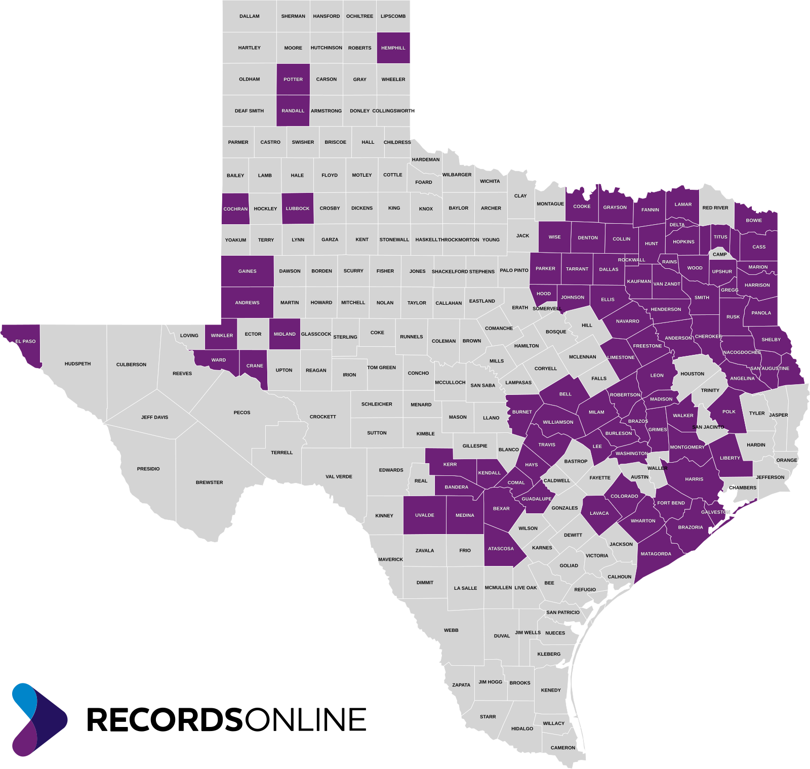
THE FOUNDATION
The regulatory bar most AI-title vendors cannot clear.
94 and Counting
Licensable Texas Counties
.
Geographically Based Plants
~80%
of Texas Population
Covered by our licensable plant footprint.
PATENT
Search-Monitor-Notify System
U.S. Patent No. 11,023,450 — owned end-to-end by RecordsOnline.

Slide 6



THE AI SUITE
One workflow. Three AI engines.
Reviewed by a professional examiner at every step.
STEP 1
STEP 2
STEP 3
ChainOfTitleAI
RunsheetAI
CommitmentAI
Build the chain.
Generate the runsheet.
Draft the commitment.
AI assembles a complete chain of title from the geographically indexed plant — every tract, every party, every instrument.
AI converts the approved chain into a clean, structured runsheet — ready for examination, with annotations and collaboration intact.
AI populates Schedules A, B, and C from the approved runsheet in your standard language — pushed straight into your production system.
HUMAN-IN-THE-LOOP, EVERY STEP • A PROFFESSIONAL EXAMINER REVIEWS EVERY OUTPUT BEFORE IT REACHES YOUR FILE

Slide 7









HOW AN ORDER MOVES THROUGH RECORDSONLINE
AI handles volume. The examiner makes the judgment.
1
AUTO
2
AUTO
3
AI
4
5
AI
Order Intake
Order QA Review
ChainOfTitleAI
Examiner QA
RunsheetAI
Manual orders +
integrations
Automated
validation
Reads thousands
of docs in minutes
Reviews + approves
the chain
Structured runsheet
with annotations
9
AUTO
8
7
AI
6
System Delivery
Examiner QA
CommitmentAI
Examiner QA
Direct into your
production system
Final review
before delivery
Schedules A, B, C
in your language
Reviews + refines
the runsheet
↺ AI flags issues → human corrections → back into the flow
Automated process
AI step
Human review

Slide 8



WHY TITLE AGENTS ARE CHOOSING THE AI SUITE
Hours, not days. Accuracy you can rely on. Speed your team can feel.
Hours, not days.
An examiner must open and read every relevant instrument by hand — a task that can take days on large or complex files. Our AI reads thousands of documents per file in minutes. The examiner's thoroughness is preserved. The hours spent are not.
Accuracy you can rely on.
Every AI output is grounded in real plant records and reviewed by a professional examiner before it leaves our platform. What you get is what's in the records — refined by years of OCR and AI quality control on the RecordsOnline plant.
Speed your team can feel.
One examiner using the AI Suite produces what a team produces today. Residential lot & block commitments delivered in two days or less — as fast as same day. No retyping. No reformatting. No broken workflow.

Slide 9


FITS YOUR PRODUCTION SYSTEM
Send the order. Receive a finished commitment.
No rekeying. No reformatting. No broken workflow.
YOUR PRODUCTION SYSTEM
WHAT YOU GET BACK
Qualia
Order
RecordsOnline
AI Suite
Examiner-approved chain of title
SoftPro
RamQuest
Structured, examined runsheet
ResWare
Schedules A, B, and C in your language
Closingsite
Commitment data file — direct import
Settlor
Commitment
ClosingUSA
Same-day/Next Day residential commitments • Zero rekeying

Slide 10
WHAT CLIENTS SEE
Faster. Deeper. Reliable.
Same-Day/
Next Day
1000s
Zero
20 yrs
Residential Commitments
Documents Per File
Rekeying
Avg. Examiner Experience
Lot & block delivered as fast as same day with AI.
AI reads thousands of instruments per file in minutes, not days.
Commitment data files import directly into your title production system.
A professional examiner reviews and approves every chain, runsheet, and commitment.

Slide 11






WHO IT'S FOR
Built for everyone who works the records.
Title Agents & Underwriters
Lenders
Oil & Gas Operators
Consistent, reliable runsheets and commitments at scale.
Monitor borrowers between commitment and closing.
Lease checks, run title, and shared runsheets across counties.
Attorneys
ROW Agents, Surveyors & Appraisers
Banking & Real Estate Teams
Title opinions and curative work, anchored in real records.
Geographically indexed records — every tract.
Tailored title and notification workflows.
Generally available now across all 94 and growing licensable Texas counties.

Slide 12
SEE IT IN ACTION
Stop by our booth
at TLTA 2026.
Schedule a Live demo of ChainOfTitleAI, RunsheetAI, and CommitmentAI.
AT THE SHOW
AFTER THE SHOW
Frisco, TX • June 8–10, 2026
RecordsOnline.com
Visit our booth for a live walkthrough and Q&A with our team.
Schedule a demo or contact your Business Development Manager.
RECORDSONLINE • TYLER, TEXAS • 94 AND GROWING LICENSABLE TEXAS COUNTIES

